Slide 1

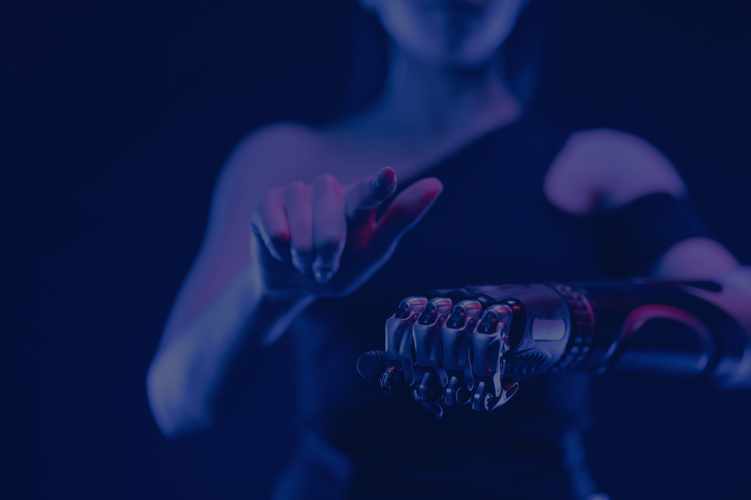

Final Portfolio
AI Applications Portfolio Assignment
Morathi Lincoln Mnkandla
About Me:
I am a student at Houston Community College, pursuing a Bachelor of Applied Technology (BAT). My experience includes analyzing data to uncover patterns and insights through techniques like exploratory data analysis (EDA) and creating meaningful visualizations. I’ve also worked on projects such as building a spam email detector, designing an algorithm to predict hit songs, and am currently exploring the development of chatbots, demonstrating my ability to apply AI techniques to solve real world challenges.

Slide 2
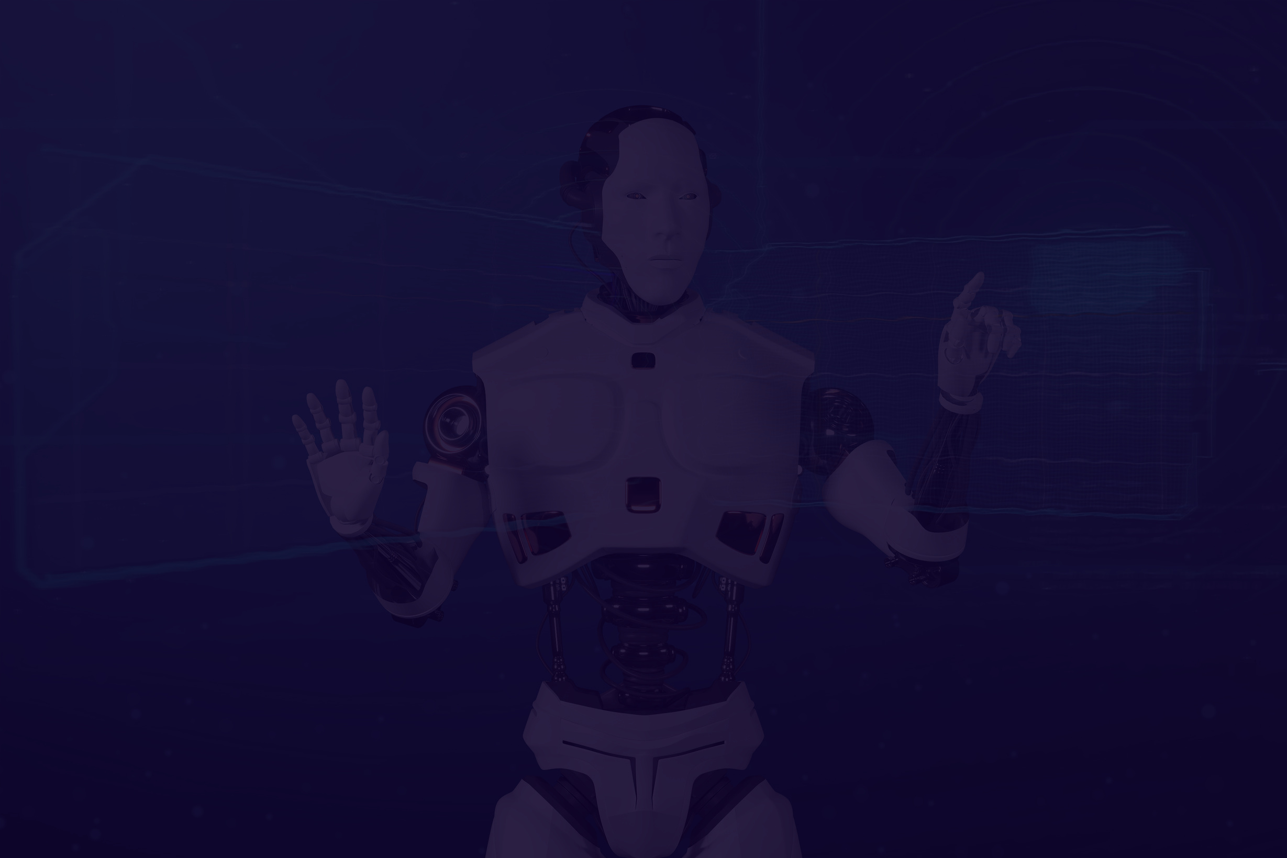
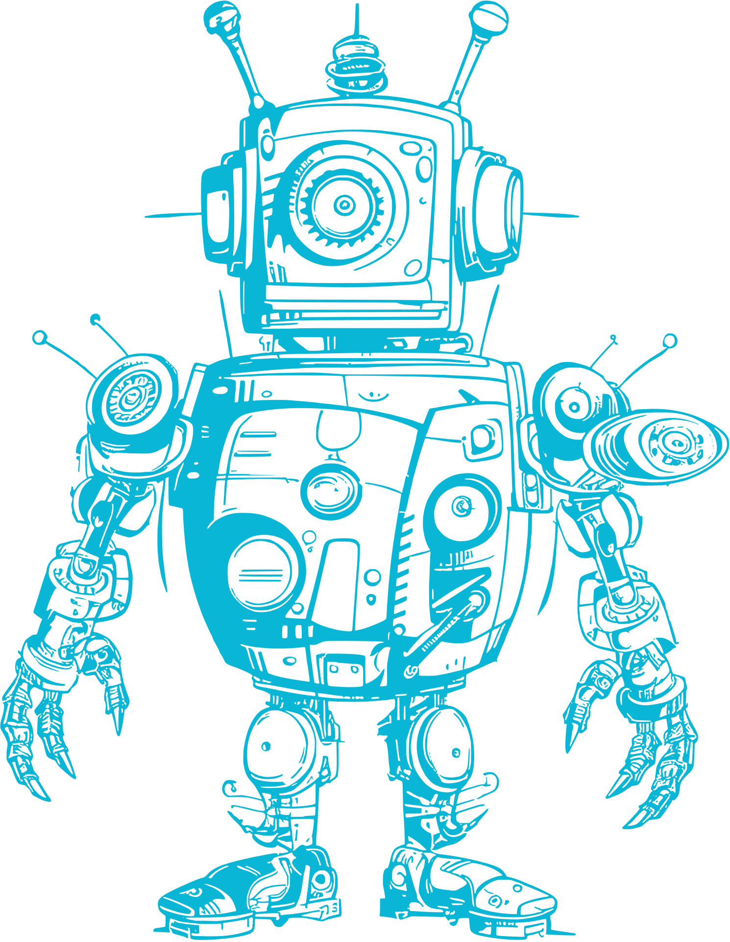

02
Final Portfolio
Course Highlights/Key Projects
Key Assignment 1 of 3: Analysis of "2057- Michio Kaku: The Body (Ep. 1)"
This project deepened my understanding of AI's impact on healthcare by comparing futuristic predictions to today’s advancements. I reflected on how wearable tech, like smartwatches, and tools like IBM Watson Health embody aspects of Kaku’s vision, particularly in diagnostics and personalized medicine.
The ethical dilemmas of health data privacy and equitable AI access stood out as critical challenges, prompting me to think about how policies can shape the future of AI-driven healthcare. This assignment connected AI theory with its real-world implications, giving me valuable insights into its societal impact.
Key Assignment 2 of 3: Analysis of AI Advancements and Global AI Regulations
This project allowed me to explore groundbreaking AI technologies like ChatGPT-4, DeepMind's AlphaFold, and Tesla's Full Self-Driving Beta. I reflected on how these innovations are shaping industries—from healthcare and drug discovery to autonomous transportation. For instance, ChatGPT-4’s multimodal capabilities fascinated me for its potential to redefine education and content creation.
In addition, comparing AI regulations between Australia and the EU broadened my understanding of global governance approaches. While Australia adopts a flexible, innovation-friendly stance, the EU enforces strict rules for transparency and accountability. Analyzing these differences helped me appreciate the delicate balance between fostering innovation and ensuring ethical AI practices. This assignment deepened my insights into AI’s global impact and ethical considerations.

Slide 3

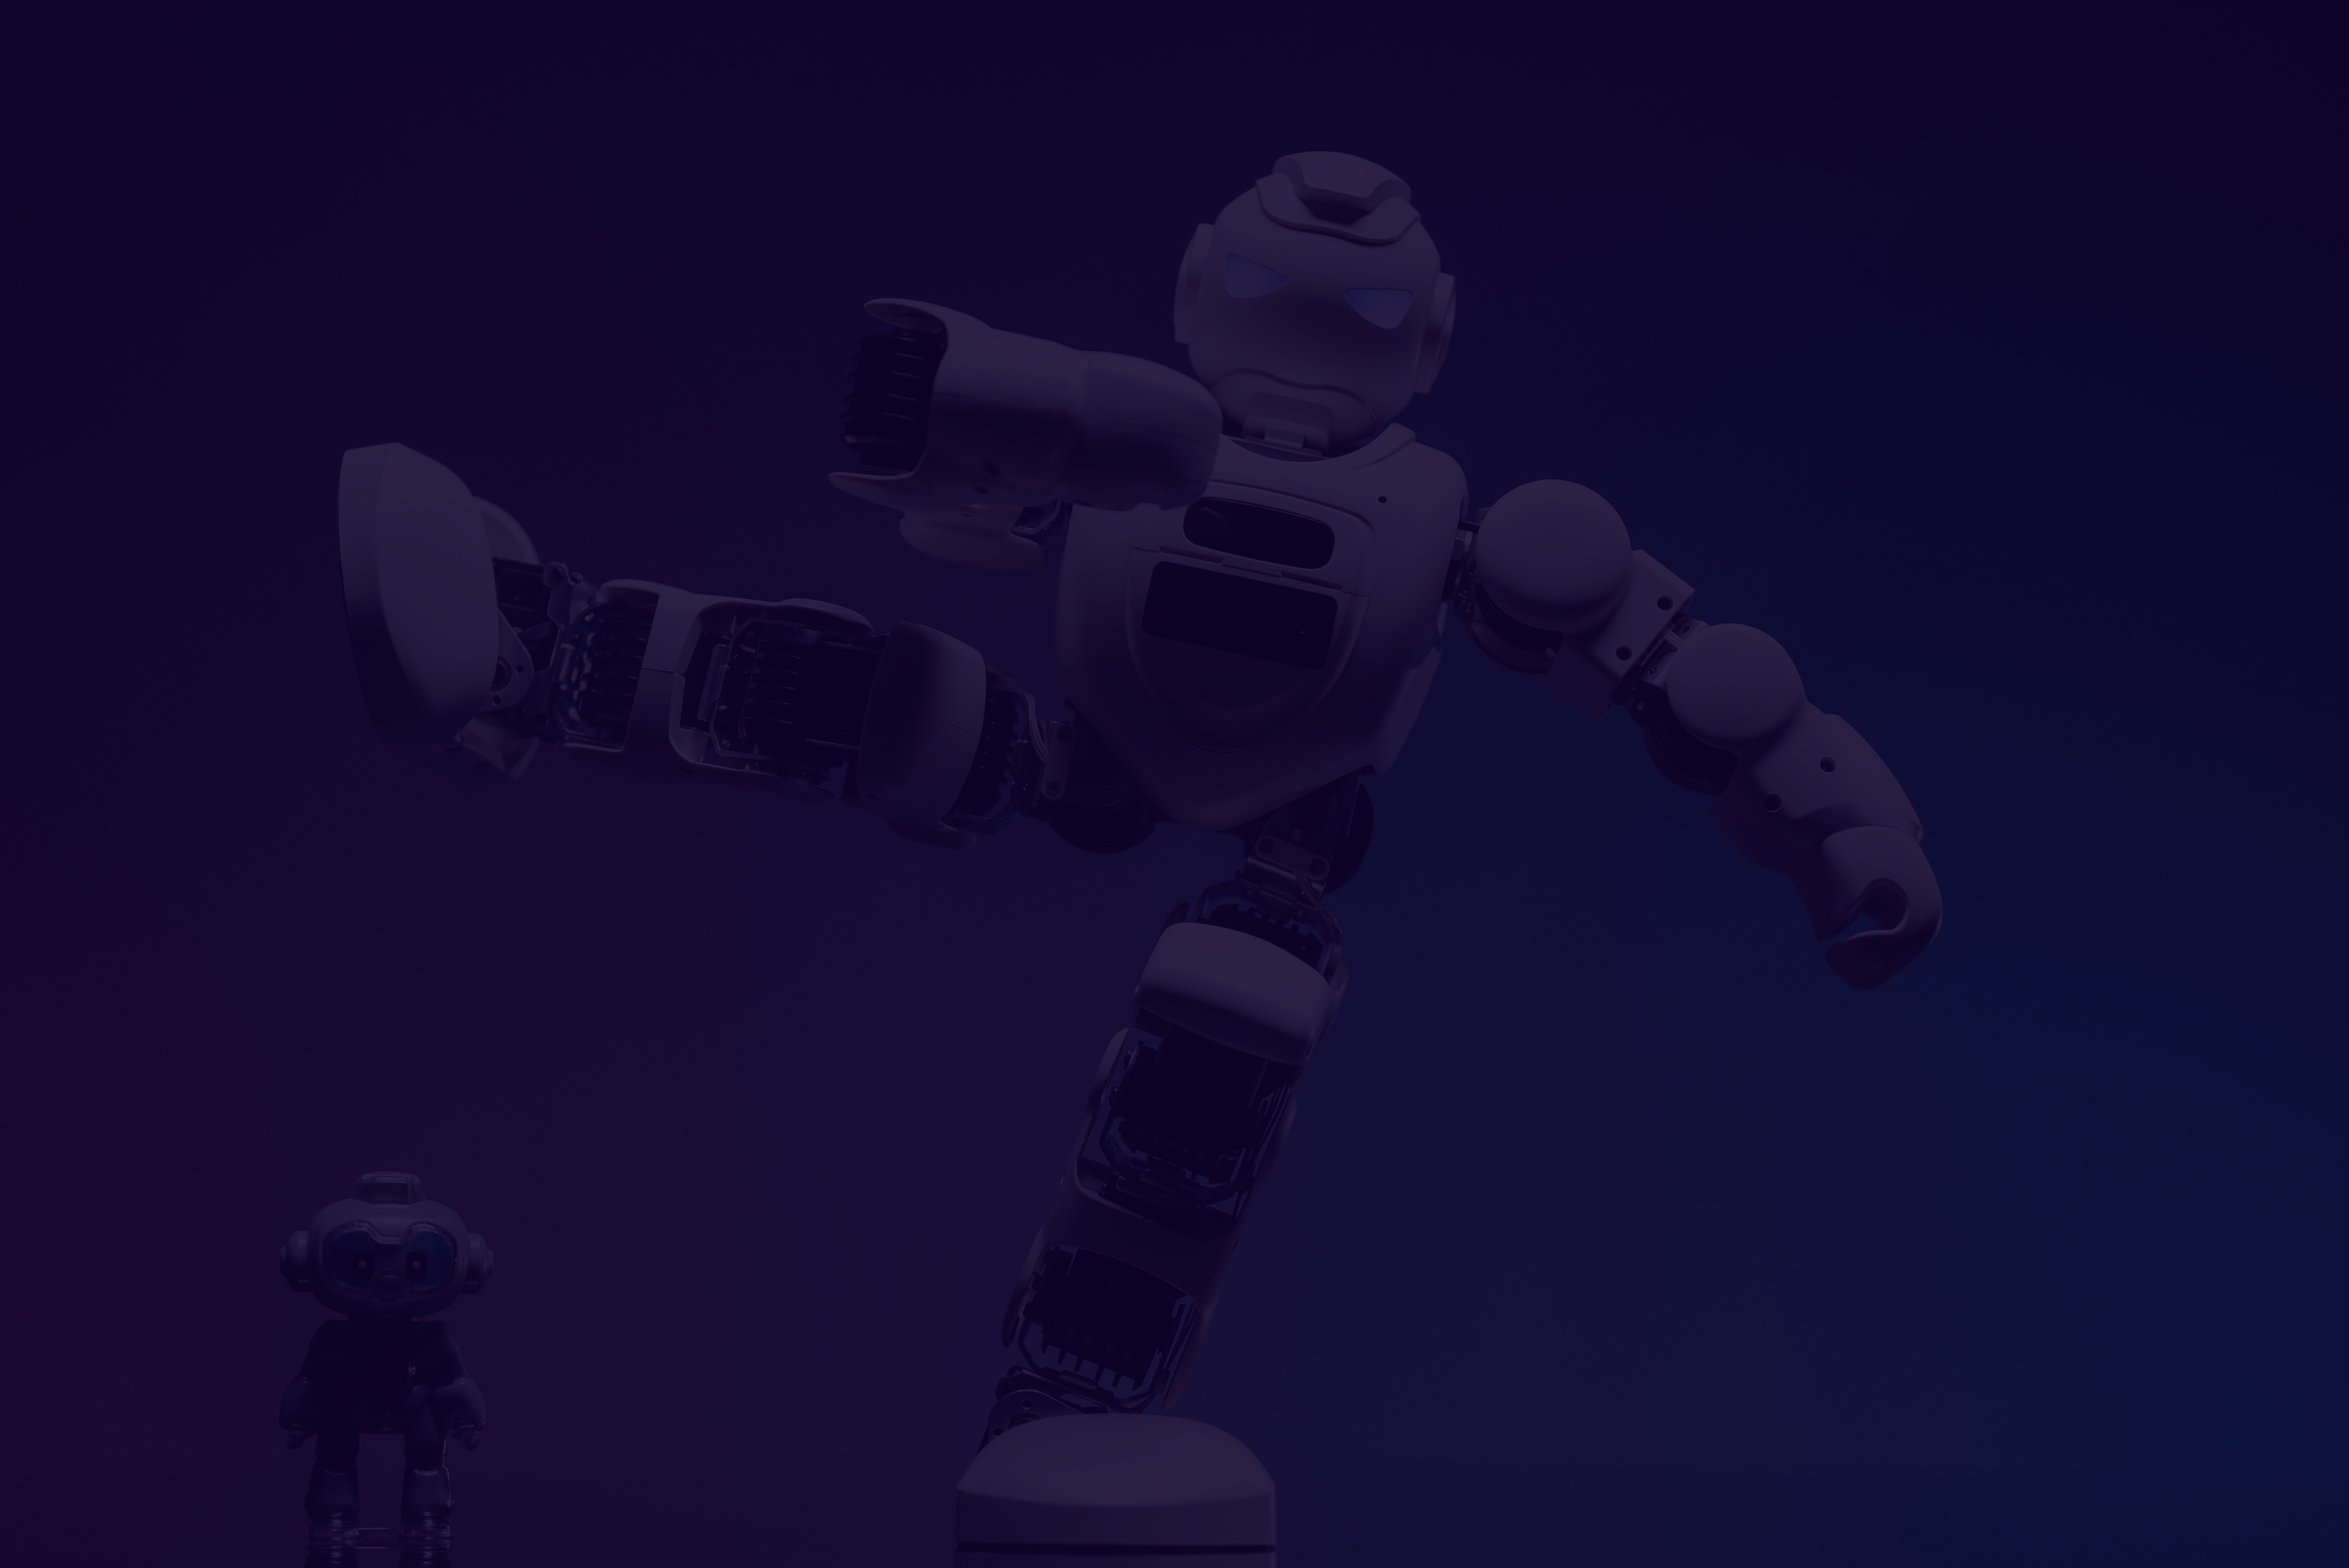
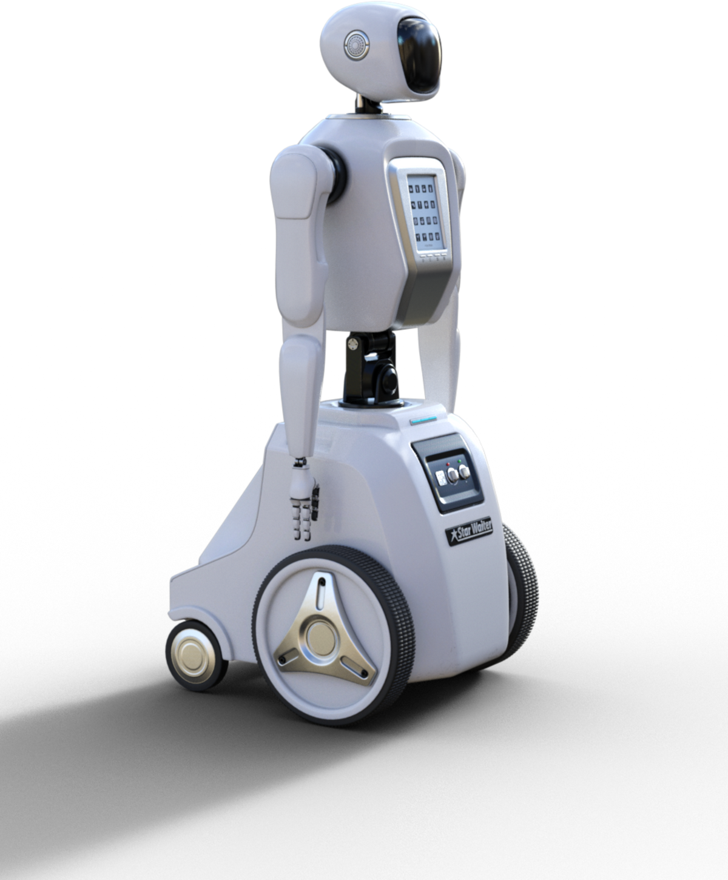
Final Portfolio
Course Highlights/Key Projects
Key Assignment 3 of 3: NASA Space Mission AI Project
This assignment was designed to challenge us to create an AI solution tailored to NASA's space mission needs. We were given two options:
Implementation Track - Build a working AI prototype.
Conceptual Design Track - Develop a detailed proposal for an AI solution.
Our group chose the Conceptual Design Track, which focused on researching and outlining a robust AI plan. The project involved creating a GitHub repository to document our work, writing a detailed solution plan, and presenting our findings through slides.
We collaborated to brainstorm ideas, researched space mission challenges, and designed an AI system capable of addressing specific problems NASA might face. Our efforts included drafting testing strategies, considering scalability, and ensuring feasibility for future implementation. This project sharpened our skills in technical planning, teamwork, and real-world AI applications. This assignment was particularly special to me as it has sparked a potential avenue to research whilst completing my studies at HCC and beyond!
03

Slide 4

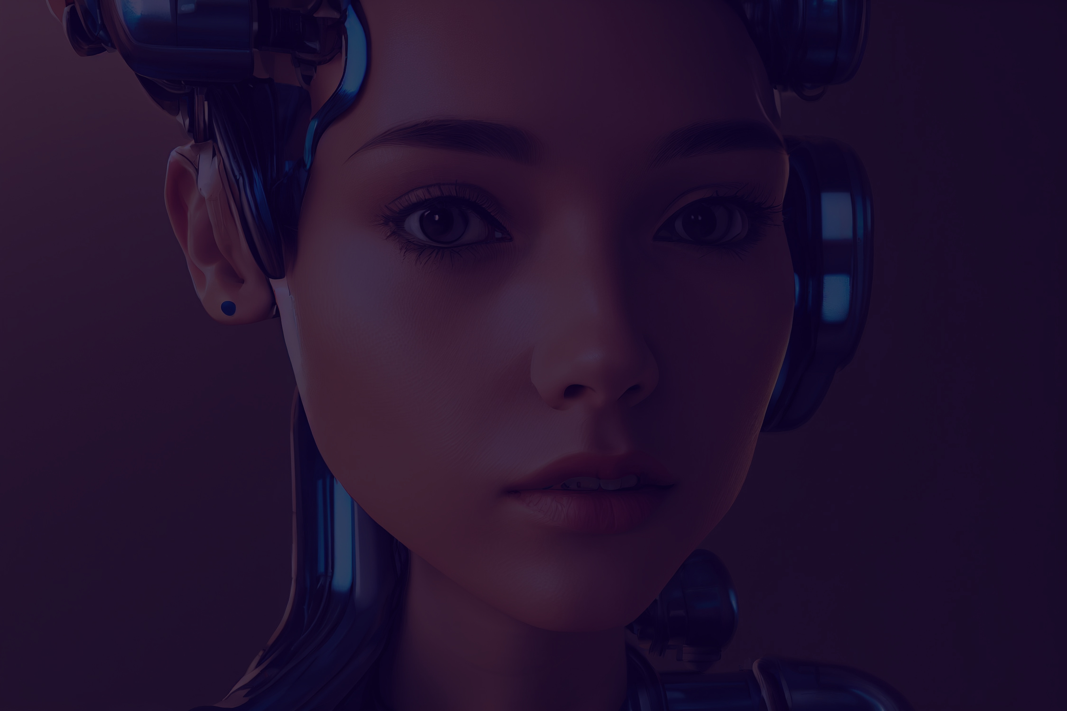
Final Portfolio
Real World Applications
How I Can Apply What I Learned:
AI in Healthcare: Insights from analyzing "2057 - Michio Kaku: The Body" help envision solutions in personalized medicine, wearable tech, and predictive diagnostics.
Advising Chatbots: Applying knowledge from the HCC AI Advisor project to streamline processes in student support and customer service.
Space Mission AI: Using the NASA AI project framework to solve complex problems in robotics, exploration, and data analysis.
AI Regulations: Comparing AI policies like those of the EU and Australia provides a foundation for shaping ethical AI solutions.
Industries/Problems I Can Tackle:
Healthcare: Innovating AI applications for diagnostics, wearables, and mental health support.
Education: Designing AI-powered systems to enhance accessibility and streamline operations.
Aerospace: Supporting mission planning, resource optimization, and autonomous systems.
Policy & Governance: Advising on ethical AI practices and creating equitable regulations.

Slide 5





Final Portfolio
Thank You!
Relevant Certifications/Skills
Skills
Data Analysis & Visualization: Proficient in EDA, trend analysis, and visualizations using Python and Power BI.
Machine Learning: Experience in building models for regression, classification, and clustering with Scikit-learn.
Deep Learning: Knowledge of neural networks for tasks like image recognition and NLP.
AI Applications: Currnetly exploring chatbots, sentiment analysis, and recommendation systems.
Cloud Computing: Hands-on experience with AWS and Azure AI tools like SageMaker and Azure ML.
Programming: Strong Python expertise for data analysis, ML, and automation.
Natural Language Processing: Worked on sentiment analysis and chatbot design.
Collaboration: Effective teamwork on AI-driven projects.
Communication: Clear presentation of findings and project documentation.
Certifications
Microsoft Certified: Azure AI Fundamentals
Microsoft Certified: Azure AI Engineer Associate
Microsoft Certified: Power BI Data Analyst Associate
AWS Certified Cloud Practitioner
AWS AI Practitioner
AWS Certified Machine Learning
Machine Learning Specialization
Deep Learning Specialization
Get in touch with me
346-228-9178
https://github.com/Morathi-Academic/ITAI2372.git
W214708568@student.hcc,edu

